Slide 1
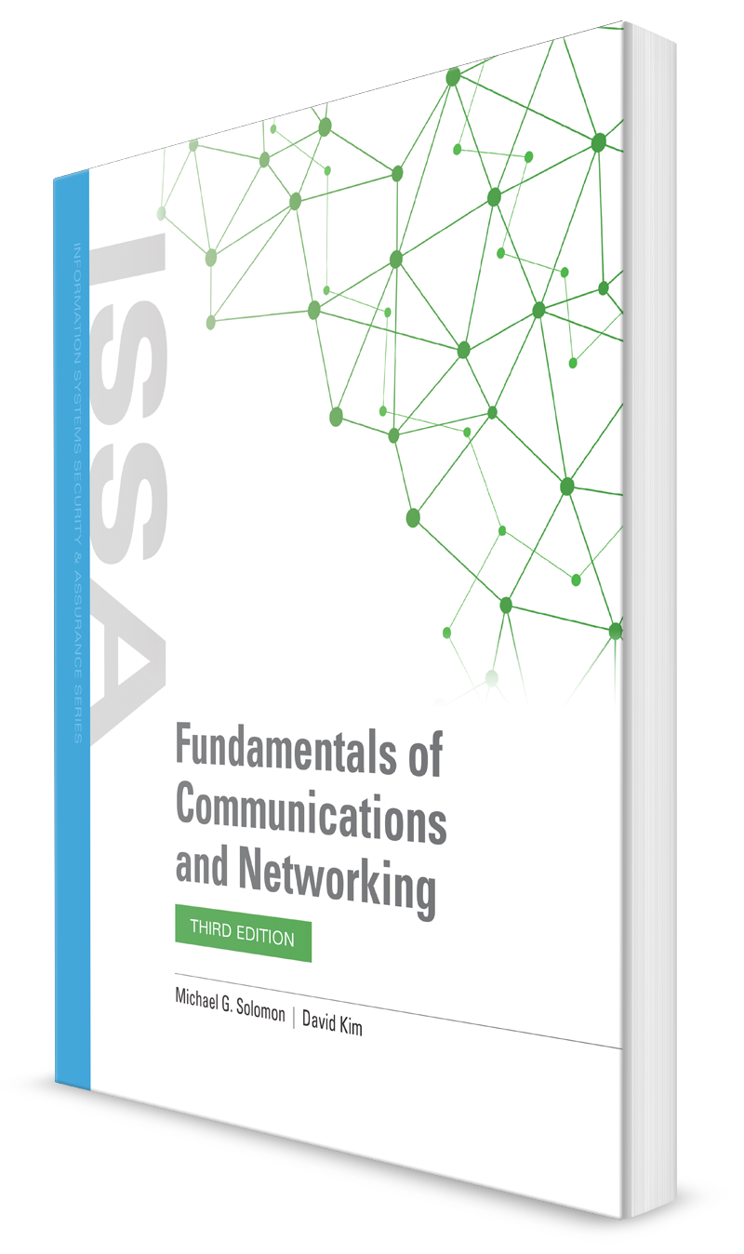
Evolution of Communication Technologies
CHAPTER 1

Slide 2
Learning Objective(s) and Key Concepts
Learning Objective(s)
Key Concepts
Explain how the evolution of communications and networking technologies solves business challenges.
The hyperconnected world
The Internet and IP connectivity
Unified communications (UC)
Snail mail, store-and-forward messaging, social media, and real-time messaging
How the web, the Internet of Things (IoT), and cloud computing have transformed business
Notes:
Internet of Things (IOT) – should know this

Slide 3





Today’s Hyperconnected World
Hyperconnectivity
Computers, smartphones, tablets, printers, automobiles, refrigerators, doorbells, security systems, and more connect to digital networks
People are connected to their homes and offices more than ever before
Notes:
All connected to the Internet in some kind of way
Each device must have at least an IP address to be able to communicate on the Internet
Hyperconnectivity – The state of being in close proximity to multiple devices that are perpetually connected to the Internet

Slide 4

Today’s Hyperconnected World (Cont.)
Hyperconnectivity Advantages
Few transactions require a physical presence
Ability for remote transactions applies to both personal and business activities
Hyperconnectivity Drawbacks
People frequently check their smartphones
Expectation that everyone is online, connected, and available all the time
Difficult to put phone down and focus on face-to-face conversations
Information overload
Is a growing challenge to business operations
Notes:
The world is smaller because everything is connected together.
It’s affecting us as a people
Businesses find it a challenge – difficult to stand out, ads are maturing to avoid getting lost among all the others, changes in attracting customers and investing in postconversion customer care

Slide 5
Evolution from Analog to Digital to Internet and IP
Analog
Telephone
Fax machine
Telegraph
Answering machine
Digital
Computer
Smartphone
Internet
Broadband/wireless

Slide 6
note
Analog – transmission method that uses a continuously variable signal
Limitations that made it difficult to do much more than engage in voice convos and transmit data slowly
Letters used instead (main communication method, thousand years practice)
Fax machines – scan multiple-page documents and transmit document imag
Beepers and pagers
Digital – transmission method that uses two distinct signal values, high and low, or 0 and 1
Broadband – Telecommunications signal of greater bandwidth than normal signals
Bandwidth – The rate of data transfer or throughput, a theoretical maximum capability of a specific physical medium

Slide 7
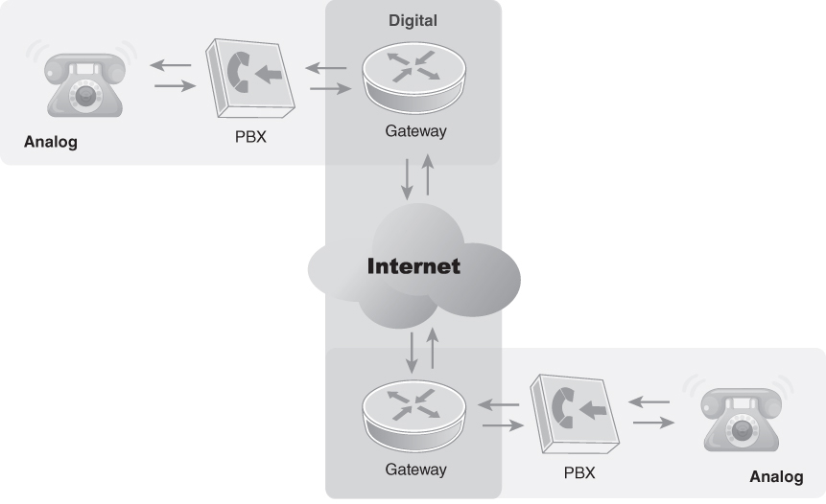
Network with Analog and Digital Segments
FIGURE 1-2 Network with analog and digital segments.

Slide 8
note
Pushing packets to the internet
Trying to connect to the internet
Everything’s trying to talk to the Internet
Analog media – network devices translated messages from analog to digital and back again many times as the messages traveled to their destinations
made it easy to use telecommunication equipment
Demand for services and speed (max bandwidth)
Replace analog segments with digital segments (upgrading network access hardware and laying new cable)

Slide 9
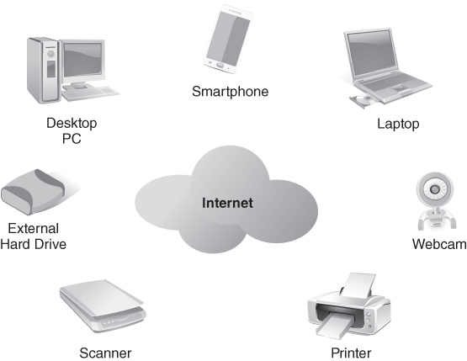
Devices that Use Wired and Wireless Connections to the Internet
FIGURE 1-4 Devices that use wired and wireless connections to the Internet.

Slide 10
note
IP – Internet Protocol
ISP – Internet service provider
Provide a unique IP address or range of them for their customers
Customer connects to the ISP’s network and uses the assigned IP address to exchange messages with other computers and devices on the Internet
Any computers or devices connected to the customer’s network can potentially access the Internet’s resources using the single ISP connection
IPv4 = 32bit, group of four bytes, separated by periods (ex. 192.168.1.254)
IPv6 = 128bit, group of eight 2-byte numbers (hexadecimal), separated by colons (ex. 2001:db8:45a5:3:200:f8fb:fe21:67cf)
Attempts to improve IP network efficiency
Easier to aggregate subnets using routing prefixes
Reduces overall traffic
Reduce Internet’s bandwidth use = more efficient

Slide 11
note
Private IP addresses
Possible for devices to connect to the Internet without having a globally unique IP address
Nonroutable = addresses valid only for private networks, not the Internet
Provide organizations with ability to create their own network with standard IP addresses
It only needs a single IP address (all others can be private)
IPv6 calls the equivalent of private IP addresses unique local addresses (ULAs)
Not routable on the Internet but can be on private networks
Prefix: fc00::/7
Actual usable space fc00::/8 through fdff::/8

Slide 12
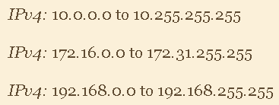

note
Ranges of private IPv4 and IPv6 addresses:
Organizations can assign IP addresses in the private address ranges or set up a server or device to dynamically assign private IP addresses as needed
Dynamic Host Configuration Protocol (DHCP) → automatic configuration protocol to assign device attributes to devices on IP addresses
Notes:
Wireless networks:
Make connecting computers and devices much easier than in the past
Make it possible to connect computers and devices to home and business networks and the Internet where no network cables exist

Slide 13
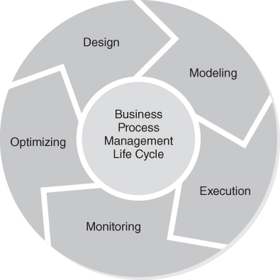
How Unified Communications Connect People and Businesses (1 of 2)
Business Process Management (BPM)
Streamlines business processes
Minimizes amount of information users receive
Emphasizes process flow, required information, and process automation
Promotes better decision making, competitive advantage, and customer responsiveness
FIGURE 1-5 Businesses process management (BPM) life cycle.
Data from Liu, Dale and Luigi DeGrande., Introduction to Networking in Cisco CCNA/CCENT Exam 640-802, 640-822, 640-816 Preparation Kit, Syngress, 2009.
Notes:
Good side ^^
What is streamline? → make something more effective and efficient by employing faster or simpler working methods
Empowers organizations to be more productive and effective
Relies on reducing redundancy and increasing automation
Goal is first bullet on slide + create an environment that promotes competitive advantage and customer responsiveness

Slide 14
notes
UC can improve communication efficiency in many areas:
Reducing communication between modules and streamlining critical software apps
Making communication less time-consuming and increasing customer service effectiveness
Reducing wasted calls when managing customer relationships
Targeting critical decisions in the enterprise resource planning (ERP) process
Automating tedious portions of supply chain management (SCM) and sales force automation (SFA)
Analyzing current communication and using technology to unify communication methods can make an organization more effective (reduce # of messages sent and received, ensure correct recipient and just enough info necessary)
→ Requires fewer devices and less network bandwidth to communicate → equipment costs go down

Slide 15
How Unified Communications Connect People and Businesses (2 of 2)
Unified communications (UC)
Developing effective BPM process often attempts to bring all communication mediums together into a unified structure = UC
UC combines multiple technologies to provide effective real-time and non-real-time communications
Telephony
Presence/ availability
Instant messaging
Video conferencing
Collaboration
Notes:
Designing your infrastructure, all of this has to be integrated
The UC system is a way to integrate all the different devices that may have different protocols
How all of them can be put together and be made to perform whatever functionality they’re designed to do, especially when trying to access Internet
Ex. Webex can have messaging, video conferencing, calling, etc.

Slide 16
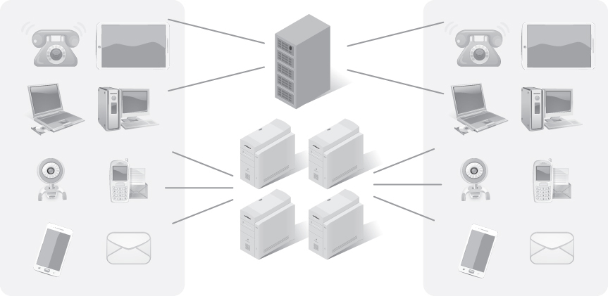
Unified Communications
FIGURE 1-6 Unified communications.

Slide 17
Benefits of UC (1 of 2)
Better support of remote and mobile users
Increased ability to conduct teleconferences and video conferences
Higher worker productivity and retention
Reduced sales cycle timeline
Notes:
Better support of remote and mobile users, which reduces the number of workers that need a physical office; this can reduce the facilities an organization must maintain.
Increased ability to conduct teleconferences and video conferences, which can reduce travel expenses for meetings and training.
Higher worker productivity and retention because remote worker support provides more flexibility to conform to personal needs and schedules.
Reduced sales cycle timeline due to more effective communication with all parties involved in the sales effort.

Slide 18
Benefits of UC (2 of 2)
Shortened project timelines
Better identification of communication paths to resolve questions and issues
Increased customer satisfaction
Notes:
Shortened project timelines due to a reduced lag time in communications.
Better identification of communication paths to resolve questions and issues.
Increased customer satisfaction due to more effective communication throughout the issue resolution process.

Slide 19
notes
Sender chooses delivery method (responsibility to compose, choose recipient)
Not all senders understand delivery method impact (time sensitivity)
Most senders have more to do than monitor messages they send
Most methods require that the sender know the recipient to send a message
Store and forward communication: A communication method where the sender sends a message to an agent that stores the message until the recipient retrieves it from the agent

Slide 20
How Communications Have Evolved
Snail Mail
Written documents sent through a delivery service, such as USPS or FedEx
Store-and-Forward Messages
Email
Real-Time Communication
Social networking, such as Facebook, Instagram, and LinkedIn
Social Media
Face-to-face meeting
Telephone
Instant messaging
Text messaging

Slide 21
notes
Face to face meeting:
Advantage: Full spectrum of communication, voice inflection, nonverbal cues, expressions
Disadvantages: Requires all parties to be present, more expensive if travel
Video conference (advantages are mostly face-to-face)
Disadvantages: Not as intuitive, miss nonverbal cues, camera quality and FOV, requires hardware and software and network support for each person
Telephone conversation
Advantages: Low cost, convenient
Disadvantages: nonverbal cues, less personal

Slide 22
notes
IM:
Advantage: Easy to participate informally for general timely messages, enables multitasking
Disadvantage: low attention requirement, difficult tonal wise
SMS
Advantages: easy to carry convo anywhere, good when communicating quickly
Disadvantages: difficult tonal wise + to communicate complex, supplemental cues missing
Examples of real-time communication: Voice over IP (VOIP) and Session Initiation Protocol (SIP)

Slide 23
notes
Real-time communication subject to time-sensitive requirements:
Bandwidth – amount or capacity of # of bits transmitted per second
Time delay or latency – total amount of time elapsed (queueing, contention, serialization, etc.) from source to destination through IP network infrastructure, measured in milliseconds (ms)
Packet loss – measured as a percentage of total packets sent
Packet jitter – measure of the average of the deviation from the mean latency of the network (consistent network perf = low values) → quality of service (qos) controls or traffic prioritization can mitigate this

Slide 24

The Web’s Impact on Business
Brick-and-mortar stores have global reach by extending business to the Internet
E-commerce
The practice of doing business with remote customers over the Internet
Has changed how organizations carry out business transactions
The web has changed how organizations market their goods

Slide 25
E-commerce Business Models
Model | Description | Features
Business to consumer (B2C) | Describes business activities that involve providing products or services directly to end consumers, such as retail sales. | Typically low volume Fixed or limited pricing Little integration with customers’ systems
Business to business (B2B) | Describes activities that involve doing business with other businesses, such as within a supply chain. Common B2B interactions take place between manufacturers and wholesalers. | Much higher volume Price negotiation is common Integration with participants’ systems is common
Business to government (B2G) | Describes activities that support business activities between commercial organizations and government agencies, also called public sector organizations (PSO). | Requests for proposal (RFPs) Prenegotiated price Strict constraints on allowed products, services, and activities

Slide 26

Solving E-commerce Business Challenges (1 of 2)
Challenges that organizations face
How to expand business offerings using the web
Converting an existing organization to enable e-commerce
Ensuring data security and privacy for online customers and business partners
Incorporating online technology into the organization’s core business activities
Keeping up with new technologies
Using online resources and capabilities to reach new customers and develop ongoing relationships with them

Slide 27
Solving E-commerce Business Challenges (2 of 2)
Solving e-commerce business challenges
Determine which model will be the primary model
Online entity only or traditional + e-commerce?
Determine how you will interact with existing customers
Determine how you will find new customers
Determine how to provide the right services to convert prospects into repeat customers or long-term business partners
Create a well-designed website to conduct e-commerce
Engage with customers and prospects on social media, review and opinion apps, and company-specific apps

Slide 28
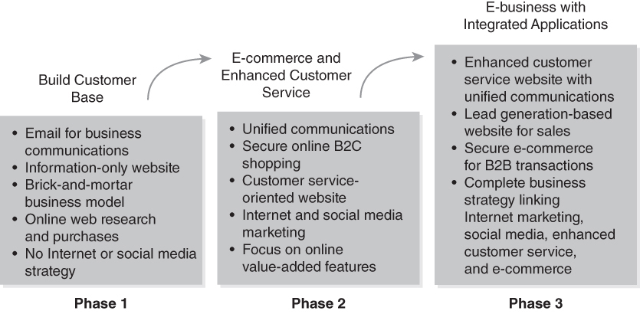
Transforming a Traditional Business Model Into an Online Model
FIGURE 1-10 Transforming a traditional business model into an online model.

Slide 29
The Internet of Things’ Impact on Business
You can track everything.
Data will grow even faster.
Administrative delays will shrink.
Waste will be easier to identify.
Identity and authorization management will become more complex.
Some jobs or roles may change or go away.
Notes:
IoT = collection of computing devices of all types and sizes connected to one another via the internet
manage devices easier (familiarity grows)
business runs smoother
Automation taking away jobs

Slide 30
The Cloud’s Impact on Business (1 of 2)
Cloud computing
Renting someone else’s computers and network to run software to support your business
Cloud service provider (CSP)
Businesses that offer cloud computing services
Virtualization
Virtual machines (VMs), dynamic provisioning, hypervisors, snapshot

Slide 31
notes
No need to invest in IT infrastructure or personnel
Virtualization – allows one physical computer to run multiple images of Oss in virtual environments (each running image is a VM)
Dynamic provisioning – On-demand deployment of computing resources through a central admin console, flexible and scalable environment to meet needs
Hypervisor – virtualization environment; a computer software that creates, runs, and manages VMs; type 1 = bare metal with HV as OS itself on host hardware + type 2 = hosted where HV operates in software layer of existing OS
Snapshot – with virtual machines, a file representing the state of a machine at a certain point in time, contains info on all changes made to machine since last saved state (last snapshot or machine itself), restores machine to its last known good state in the event of failure or misconfig

Slide 32
notes
public cloud – computing services accessible to any subscribed user over public Internet
Most common view
Called public delivery model
Consists of CSP offered to any subscribers using Internet to connect
Windows, Azure, Amazon Cloud Services
Lots of flexibility, issues with security and control
Private cloud – AKA private delivery model
Allows owning organization to provide more security than public cloud
In the organization’s data center or hosted by CSP but only accessible by users owning organization authorizes
More expensive and harder to manage

Slide 33
notes
hybrid cloud – an environment composed of at least one private and one public infrastructure
Allows any organization to use private clouds where they need to
Use public, cost-effective public cloud services for less sensitive stuff

Slide 34
The Cloud’s Impact on Business (2 of 2)
IaaS
Provision and launch virtual machines
PaaS
Develop applications
SaaS
Rent access to specific software applications
Anything as a Service (XaaS)
Extends SaaS solutions as professional services
Examples: Security as a Service, Database as a Service, Blockchain as a Service, Privacy as a Service

Slide 35
Summary
The hyperconnected world
The Internet and IP connectivity
Unified communications (UC)
Snail mail, store-and-forward messaging, social media, and real-time messaging
How the web, the Internet of Things (IoT), and cloud computing have transformed business

Slide 36
notes
What type of communication is based on publish-subscribe model? Social media
Cloud computing is made possible by what technology that supports running multiple images of OSs on a single server? Virtualization
Which device that became popular in the 1980s enabled users to send and receive printed documents using analog telephone lines? Fax machine
What is the originator behind what is known as the Internet today? US DoD
Which of the following IP address ranges is NOT a private IPv4 address range? 152.0.0.0 to 152.255.255.255
A network’s __ server provides IP addresses to devices dynamically. DHCP
The formal process of aligning business processes and mapping each one to software and IT solutions is called configuration management (CM). False

Slide 37
notes
Unified communications (UC) is the process of bringing all communication mediums together with a unified structure. True
__ communication is faster than snail mail but slower than immediate or __ communication. Store-and-forward, real-time
What is NOT a unified communications app and service? SMS text messaging
Which of the following is defined as the amount of capacity of the number of bits transmitted per second? Bandwidth
Which cloud service type provides VMs with pre-installed and configed software? PaaS
How is the term hyperconnectivity best described? Everyone is online and available all the time
What business drivers can be addressed with UC? Enhancing customer service delivery

Slide 38
notes
Businesses that transform to the web with an Internet presence and an e-commerce solution require an e-commerce service and self-serve customer service delivery strategy. True

Slide 39
quiz
Internet Protocol version 6 (IPv6) accomplishes all of the following, except:
Internet Protocol version 6 (IPv6) accomplishes all of the following, except:
IPv6 does NOT enable 2+ devices to connect to the Internet to use the same IP address
Email is NOT a common real-time communication method
Approach of sender to send a message: THIS IS NOT TRUE → reliable communication methods still require senders to monitor sent messages for errors or potentially missing messages
With real-time communications, message delivery DOES depend on the recipient being able to receive the message
Collaboration is a form of real-time communication NOT store-and-forward
A VM operates just like a physical computer

Slide 40
UC video

Slide 41
notes
Internet Protocol version 6 (IPv6) accomplishes all of the following, except:
Internet Protocol version 6 (IPv6) accomplishes all of the following, except:
Unified communications → view the communication in any form, all methods can interact with each other
VOIP *Voice over IP) instead of public switched telephone network
Federated VoIP – no centralized exchange points, anyone can talk to anyone regardless of VoIP system
Specialized protocols – call signaling, set-up, tear-down
A mix of proprietary protocols and opens standards – every implementation is different
Video streaming → Moving pictures across the network
Unicast – video server must send separate video feeds to all viewers
Multicast – video server sends one stream that all viewers can see (more common), equipment and software must be used in the environment (used for organization)

Slide 42
notes
Internet Protocol version 6 (IPv6) accomplishes all of the following, except:
Internet Protocol version 6 (IPv6) accomplishes all of the following, except:
Presence – where all communication methods know what you’re doing at any particular time (your current status, like in teams)
Available to everyone, filtered for privacy but still available
Apps designed to use it with IMs, calendar, desktop apps
Change method based on presence
QoS (quality of service) – describes the process of controlling traffic flows
Prioritize traffic performance
VOIP traffic has priority over web browsing
Prioritize by max bandwidth, traffic rate, VLAN
Managing QoS (some methods)
Class of service (CoS)
Ethernet frame header in an 802.1q trunk
Usually applied in the intranet (not from ISP), inside organizational traffic

Slide 43
notes
Internet Protocol version 6 (IPv6) accomplishes all of the following, except:
Internet Protocol version 6 (IPv6) accomplishes all of the following, except:
DiffServ (Differentiated services)
QoS bits enabled to IPv4 header
Bits set external to app
Routers and switches have to play along
DSCP (differentiated services code point) – DS field in the IP header
To coordinate UC, need UC servers
Centralized coordination of UC services
Connect users wherever they are
Connect 3rd parties to your UC environments
Might also have UC devices
Combine UC functions into a single client
Voice video calls, IMs, presence, persistent chat

Slide 44
UC article

Slide 45
notes
Internet Protocol version 6 (IPv6) accomplishes all of the following, except:
Internet Protocol version 6 (IPv6) accomplishes all of the following, except:
For UC to be successful, end-user adoption is paramount:
Provide a better user experience
Multiple standalone messaging or IM platforms
Behavior change, people only change when something’s better than before
Better collaboration outcomes with an integrated platform
Workers need to see how easier it is to get things done with the new platform
Business case to continue supporting legacy applications
Some people unable to make the switch or need UC
e

